Slide 1
Student Performance Prediction System
CODEVEDX AI/ML Internship
Developed By: Sanchit Doshi

Slide 2
Project Overview
• Predict final marks
• Machine Learning project
• Console application
• Linear Regression

Slide 3
Technologies & Dataset
Python
Pandas
Matplotlib
Scikit-learn
Dataset: Project2.csv

Slide 4
Features
• View Dataset
• Data Visualization
• Train Model
• Model Accuracy
• Predict Student Performance

Slide 5
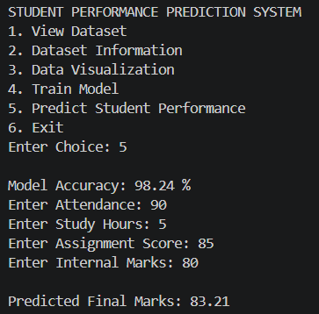
Results
Sample:
Accuracy: 97.35%
Predicted Marks: 84.62

Slide 6
Conclusion
Successfully predicts student performance using Machine Learning.
Thank You!!!

